Slide 1
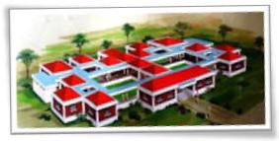

Manovikas Charitable Trust at 20 Yrs

Slide 2
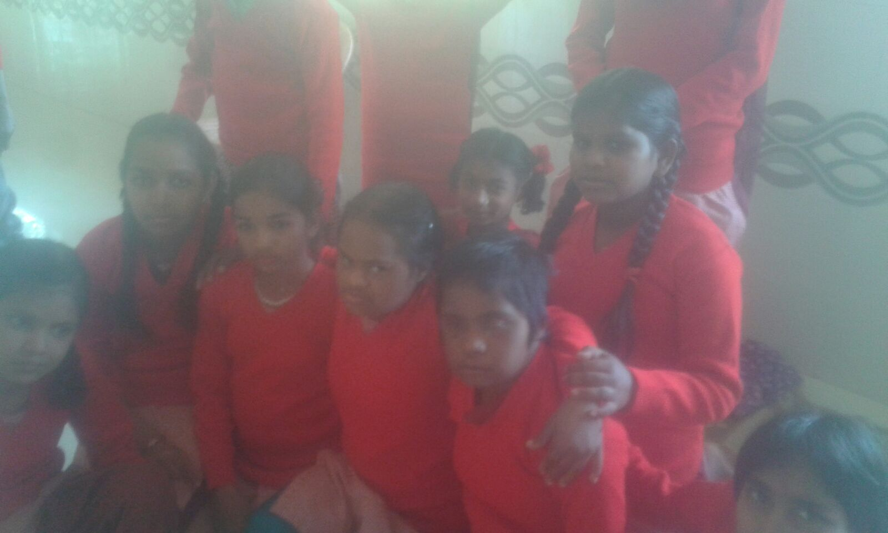
Manovikas Catersto disabled adults and children with all types and helps all the disabled people with special emphasis on M.R & H.I

Slide 3
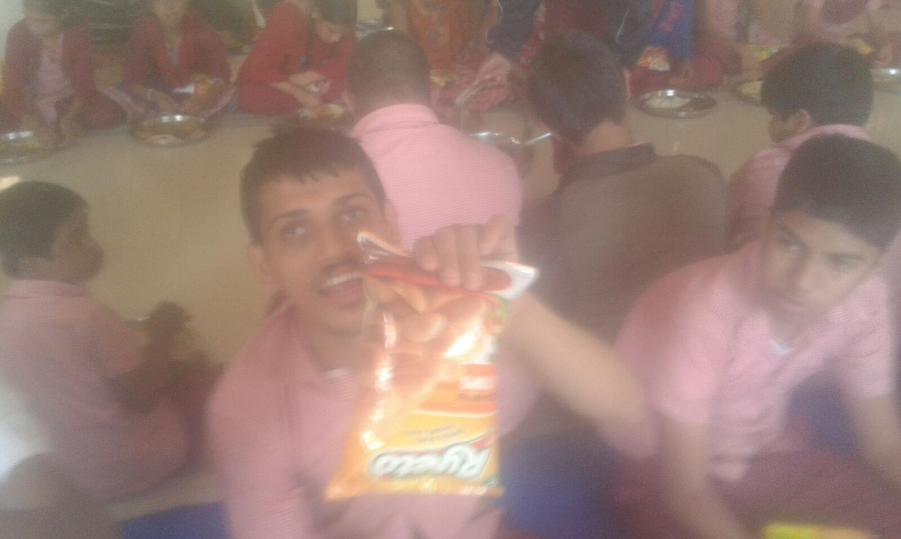
Mentally Retarded
Manovikas Rotary Vishishta Prashala
Established on 20th October, 1996.
Students – 78 children and 22 adults.

Slide 4
 | Boys | Girls | Total
Hostel | 35 | 9 | 44
Day – Scholars | 49 | 29 | 78
Total | 84 | 38 | 122
22 M.R Adults are in Pre – Vocational Group.

Slide 5
Budget
Current Budget = 17 – 18 Lac
Government Grant = 5 – 6 Lac
Technically 15 – 16 Lac is available but not delivered any time in last 10 yrs.

Slide 6
R.M Desai School for Deaf & Mute
Current Students
 | Boys | Girls | Total
Hostel | 37 | 18 | 55
Day – Scholar | 60 | 29 | 89
Total | 97 | 47 | 144

Slide 7
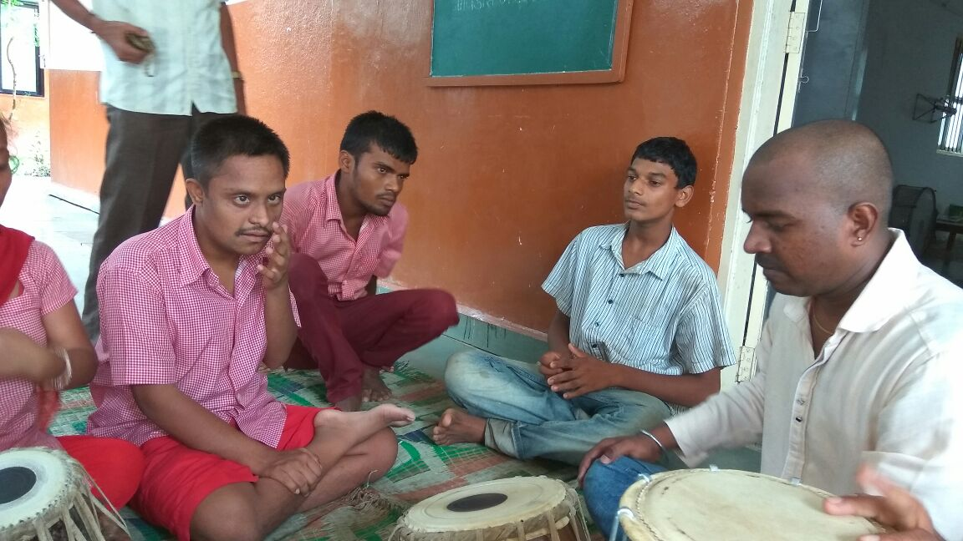
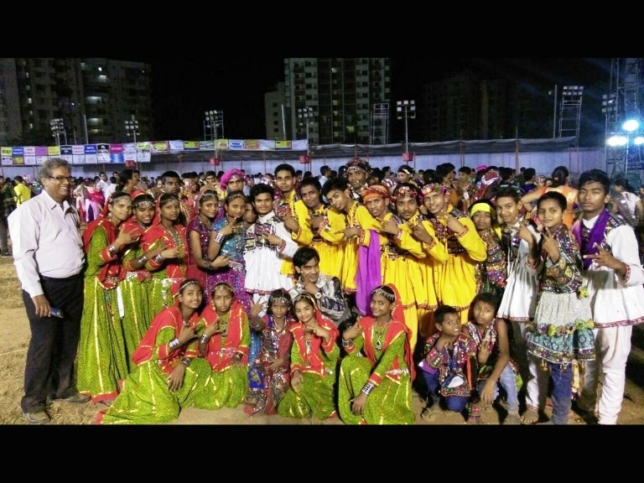
budget
Current Budget = 20 – 22 Lac
Government Grant = 12 – 13 Lac

Slide 8
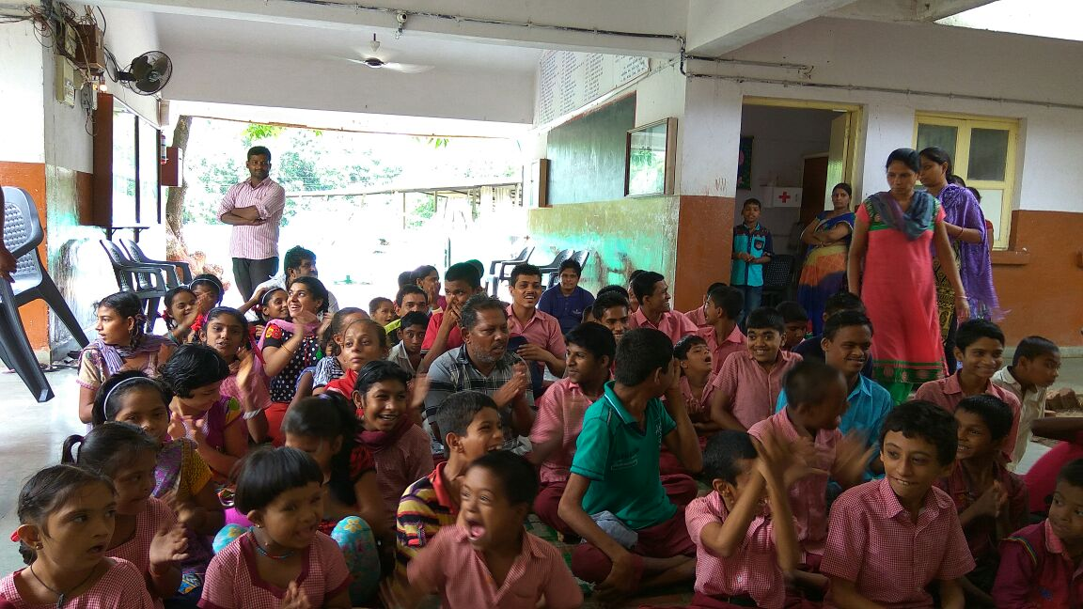
Sammilit Shikshan Yojana
Current Students – 48
Budget – 10 – 11 Lac
Fully granted by Government.

Slide 9
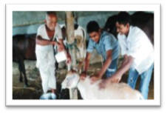
Goshala
Total Cattle heads:-
Milk Cows – 14
Total Expenses 3 – 4 Lac / yr
Total income – 20 litres / day ,330 days.

Slide 10
Overall Budget
Overall budget of organisation
Approx 45 Lac / year.
Overall Government grants 23 Lac
Overall user fees – Bus Fees – 2 Lac
Total Annual Deficit 20 Lac / year.
Total Donation Received last 3 years – 10 – 15 Lac / year
Net Loss covered by trustees variable 5 – 7 Lac per year.

Slide 11
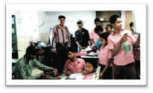
Projected expenses (Planned)
Improved Goshala – 5 Lac
Improved Workshop – 10 -15 Lac
According to availabilityof funds.

Slide 12
Land - Mark Manovikas
Established on 20th October, 1996.
Children prepared first rakhi and we sold approx. 100 rakhi.
In 1998 Diwali sold cards children participated in Local School Competition runing did not get any medal.
In June 1999, started Deaf & Dumb School.
In the year 2000 we started Karate training for students.

Slide 13
In 2001, first 8 – Green Belts to students. Sported workshop with door mat making, received donation of Land of Degam.
In 2002 construction started at Degam.
In 2003, helped Red – Cross, Silvassa to start school for disabled.
In 2004, started Integrateg Education Programme. Out reach of Manovikas shifted to Degam. Started Hostel in rental premises.

Slide 14
In 2005, started offset printing. Got medals in Yoga Competition at Bhavnagar.
In 2006, participated in Delhi Haat, with Vocational Training Programme Artificial Jewellery.
In 2007, received Award of Exellence from Government; first Black – Belt Srimanth Bal.
In 2008, started with collecting medals in Special Olympics, Valsad.
In 2010 started our own cowshed. Animal Husbandry training for students.

Slide 15
In 2011, President Manovikas Invited to Board of Arunim Association for Rehabitition under National Trust Initiative to marketing.
In 2012, started sewing with 5 – sewing machines in Vocational Training. First three students employed by factory.
In 2013, On 30th October, 2013, Pankaj Udas Programme.
In 2014, started construction of new building.
In 2014, seven students were employed in Welspun Terry Towels for sewing.

Slide 16
From 2014, started playing Cricket on 3rd December, World International Disabled Day, competiting with normal people.
In 2015, completed Dining – Hall and 1st floor (R.M Desai School for Deaf & Mute).
Srimanth Bal cerebral palsy student recognised for outstanding achievements (Black – Belt Karate) by Chief Minister.
In year 2015, M.R students went to Akashvani Daman for Bhajan presentation.
In 2016, again M.R students went to Akashvani Daman for Bhajan presentation with their Avinash Sir of Banaras Gharana .

Slide 17
In 2015, students participated in India’s Got Talent Competition Show.
In 2015, World Guinesse Record was accepted for playing Garba 9 – nights between normal students & Mukesh Sir of M.J Dance Academy.
On 17th September, 2016 a master piece of Rangoli of our Hon. P.M Mr. Narendra Modi by Prabhubhai Patel.
In 2016, Aizaz Shaikh M.R student selected in International Sports Olympic. Floor Ball event to be held at Vienna.

Slide 18
Thank You

